Slide 1

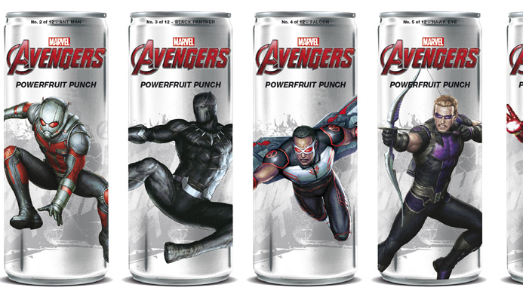
Principles of marketing final project: brand extension
AAYUSH VASHI
RICCARDO BAZZO
VARSHITHA GANGAVARAPU

Slide 2

CURRENT BRAND

Slide 3
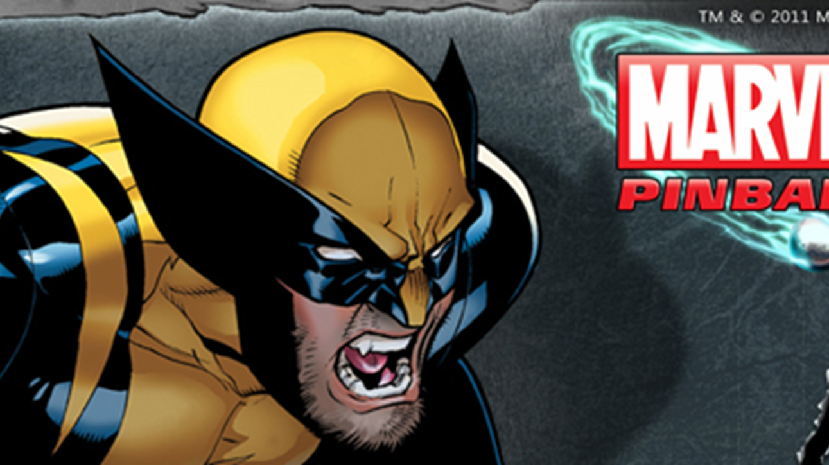
Segmentation and target market
ORIGINAL SEGMENTATION AND TARGET MARKET:
Children and young adults but was more targeted towards boys than girls
Stereo subgenres were science-fiction and fantasy
In the 1940s, Captain America, which appeared on the back pages of Marvel's detective comics, gained a new target market, young girls.
CURRENT SEGMENTATION AND TARGET MARKET:
Marvel positions their target market in categories, such as geographic segmentation, demographic segmentation and psychographic segmentation.
Marvel's target audience are between tweens and adults, about the age of 9-6
Geographical segmentation - British Captain America, which is based in Marvel UK.
Demographic segmentation - Tomi Shishido (Earth 616), a Japanese version of Wolverine and Natalia Romanova (Earth 1610), a Russian, known as the Black Widow.
Psychographic segmentation – zen pinball online game for both IOS and android users.

Slide 4
Positioning
ORIGINAL POSITIONING:
“Our mission to expand enables our legends like Thor and The X-Men to come to life in unexpected ways. To resonate with people today and to evolve with generations to come”.
CURRENT POSITIONING:
“Diversified genres of our legends and storylines allow Marvel to evolve with the generations of today and those to come. Our foundation of originality, imagination, and innovation will be guided by trends supported from our Marvel Universe enthusiasts”.

Slide 5
CURRENT PRODUCT AND PRICING STRATEGY
CURRENT PRODUCT
PRICING STRATEGY
All based on the characters of their comics.
PRODUSCTS:
American comic books
video games
Toys
Other merchandise
SERVICES:
Television shows
Movies
Being a premium brand Marvel has a lot of fan base and there is not much to talk about their pricing strategy.
In March 1963 – first ever comic sold for 12 cents.
Now they are distributed for $3.99 and $4.99 for 22 pages, and several shows produce new issues twice per month.
Digital editions are usually priced the same thing
Marvel came up with a package price plan by selling two free retro comics instead that would woo fans who want more value for money.

Slide 6
place

Slide 7
promotion
Social media
example: social media pages on many sites such as Instagram, Facebook, Twitter, etc. They used these platforms to drop the gobbets regarding their coming movies and comics.
Word of mouth
Through interviews
They send some of their actors to T.V. shows to promote their upcoming films.
Posters
Distribute merchandise

Slide 8
BRAND EXTENSION

Slide 9

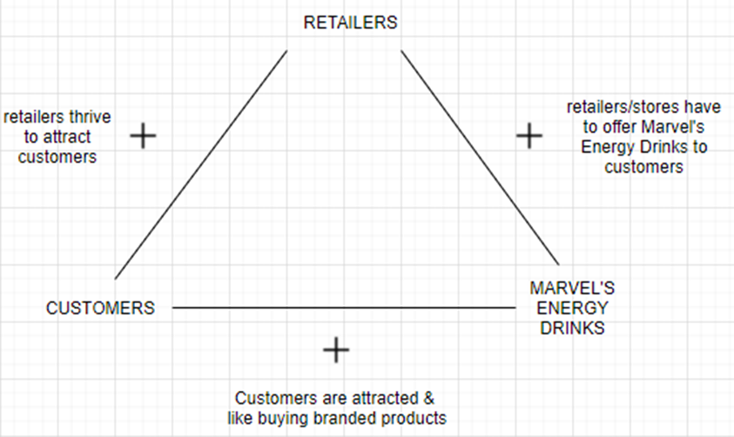
New target market for line of energy drinks
Target market I : Age range 16-36 years old, Business → to → Consumer, Hedonic Motive. also consists of individuals who look at energy drinks as an alternative to carbonated drinks. consumer = decision maker, consideration set for this target market is other products offered by Marvel
Target market II : age range 16 to 60 years old, primarily male, Business → to → Consumer, this is the market outside of the Marvel brand, these individuals are unaware of the brand or its products. This market aims to tap into consumers of energy drink competitors like Red Bull and Monster.
Target market III : Business → to → Business. This consists of retails giants like Walmart, Costco, Amazon, chain of gas station convenience stores and other chain of convenience stores such as 7-Eleven.

Slide 10
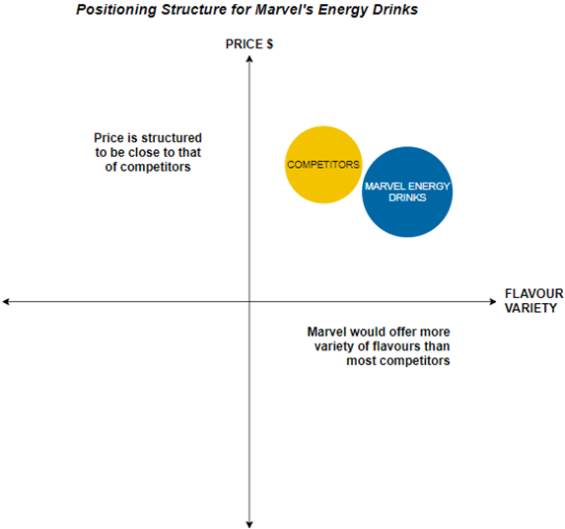
New Positioning for the line of energy drinks
The consumers of this product are expected to return and make repeat purchases of same or different variety of the Marvel’s line of energy drinks. A sense of boost of energy with a new flavour with a different Marvel character on it expected.

Slide 11
New product line

Slide 12
New pricing strategy

Slide 13

New Place for the line of energy drinks

Slide 14
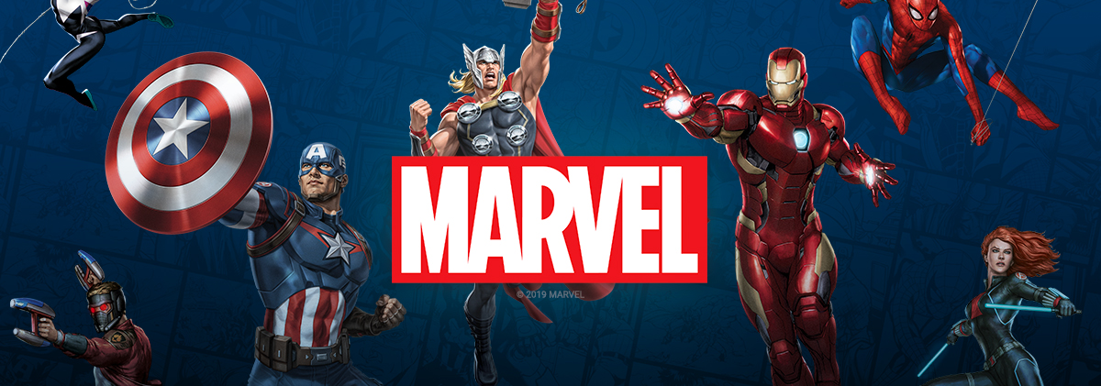
New detailed promotion plan

Slide 15
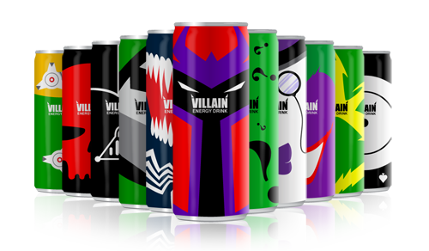

images

Slide 16
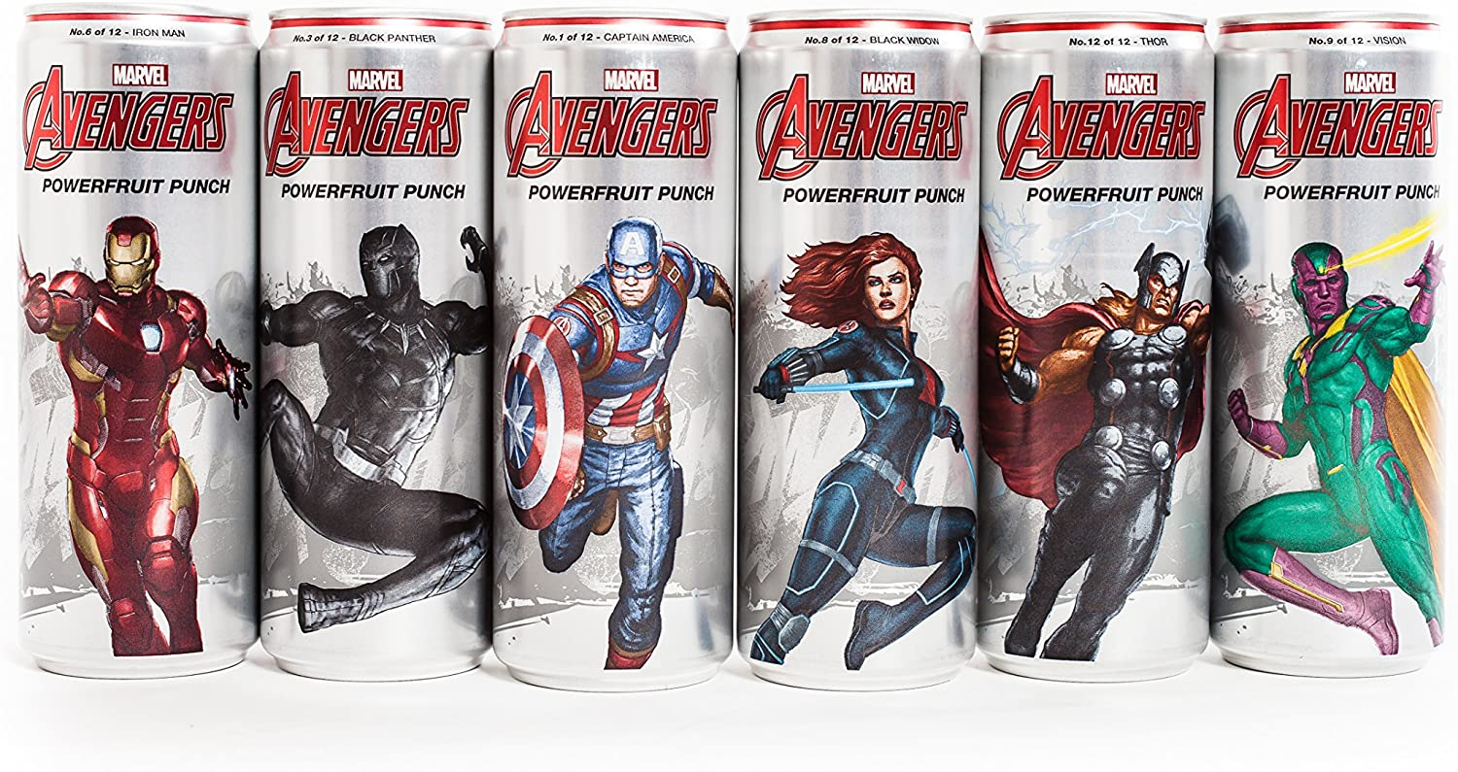
messaging
‘AWAKEN YOUR INNER SUPERPOWER’

Slide 17
media

Slide 18
timing

Slide 19
Expected outcome

